Slide 1
Secure and Efficient Medical Image Encryption using Deep Learning Methods
Joseph B Choi, Karolina Naranjo-Velasco
October 28, 2022

Slide 2
Literature Review
Medical Image Encryption (encryption algorithms, hardware-level encryption)
Image-to Image transfer by generative adversarial networks
ML/DL in data privacy
State our scope (image encryption by DL only)

Slide 3
NIH X-Ray data set
Processed 10,000 X-Ray images out of 112,120 cases
The processing step for remaining holds the same.
No missing data, no missing label
data cleaning unnecessary
Processed images are in numpy format

Slide 4
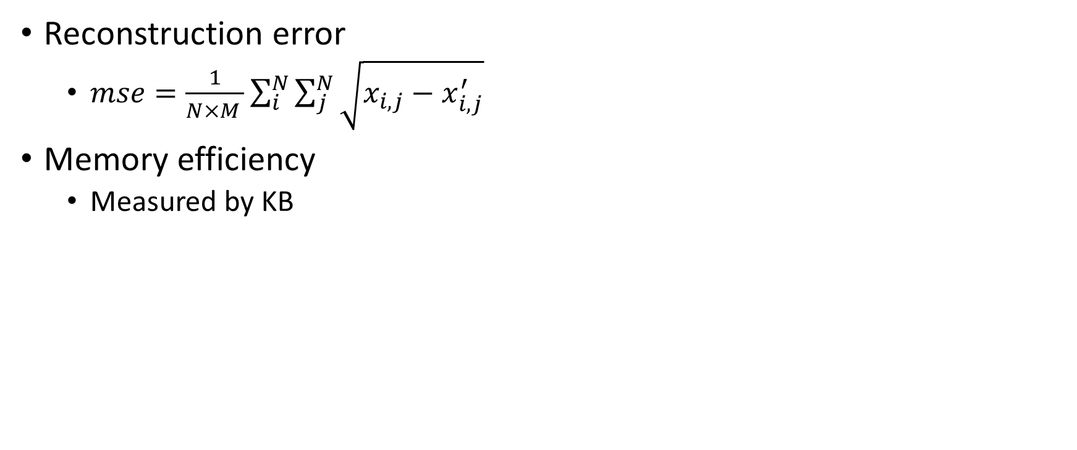
Metrics
Notes:
Next presentation:
Suvey comprehensive survey
Good start collected subject

